Slide 1
FAKULTAS TEKNOLOGI INFORMASI
KECERDASAN TIRUAN
[ KP045 / 3 SKS ]

Slide 2
KLASTERISASI DATA
Pertemuan 10

Slide 3
Tujuan Pembelajaran
Mahasiswa mampu memahami konsep klasterisasi data

Slide 4
Algoritma Klastering
Partitioning Methods
Hierarchical Methods
Density-Based Methods
Grid-Based Methods

Slide 5
What is Cluster Analysis?
Cluster: A collection of data objects
similar (or related) to one another within the same group
dissimilar (or unrelated) to the objects in other groups
Cluster analysis (or clustering, data segmentation, …)
Finding similarities between data according to the characteristics found in the data and grouping similar data objects into clusters
Unsupervised learning: no predefined classes (i.e., learning by observations vs. learning by examples: supervised)
Typical applications
As a stand-alone tool to get insight into data distribution
As a preprocessing step for other algorithms

Slide 6
Applications of Cluster Analysis
Data reduction
Summarization: Preprocessing for regression, PCA, classification, and association analysis
Compression: Image processing: vector quantization
Hypothesis generation and testing
Prediction based on groups
Cluster & find characteristics/patterns for each group
Finding K-nearest Neighbors
Localizing search to one or a small number of clusters
Outlier detection: Outliers are often viewed as those “far away” from any cluster

Slide 7
Clustering: Application Examples
Biology: taxonomy of living things: kingdom, phylum, class, order, family, genus and species
Information retrieval: document clustering
Land use: Identification of areas of similar land use in an earth observation database
Marketing: Help marketers discover distinct groups in their customer bases, and then use this knowledge to develop targeted marketing programs
City-planning: Identifying groups of houses according to their house type, value, and geographical location
Earth-quake studies: Observed earth quake epicenters should be clustered along continent faults
Climate: understanding earth climate, find patterns of atmospheric and ocean
Economic Science: market research

Slide 8
Basic Steps to Develop a Clustering Task
Feature selection
Select info concerning the task of interest
Minimal information redundancy
Proximity measure
Similarity of two feature vectors
Clustering criterion
Expressed via a cost function or some rules
Clustering algorithms
Choice of algorithms
Validation of the results
Validation test (also, clustering tendency test)
Interpretation of the results
Integration with applications

Slide 9
Quality: What Is Good Clustering?
A good clustering method will produce high quality clusters
high intra-class similarity: cohesive within clusters
low inter-class similarity: distinctive between clusters
The quality of a clustering method depends on
the similarity measure used by the method
its implementation, and
Its ability to discover some or all of the hidden patterns

Slide 10
Measure the Quality of Clustering
Dissimilarity/Similarity metric
Similarity is expressed in terms of a distance function, typically metric: d(i, j)
The definitions of distance functions are usually rather different for interval-scaled, boolean, categorical, ordinal ratio, and vector variables
Weights should be associated with different variables based on applications and data semantics
Quality of clustering:
There is usually a separate “quality” function that measures the “goodness” of a cluster.
It is hard to define “similar enough” or “good enough”
The answer is typically highly subjective

Slide 11
Considerations for Cluster Analysis
Partitioning criteria
Single level vs. hierarchical partitioning (often, multi-level hierarchical partitioning is desirable)
Separation of clusters
Exclusive (e.g., one customer belongs to only one region) vs. non-exclusive (e.g., one document may belong to more than one class)
Similarity measure
Distance-based (e.g., Euclidian, road network, vector) vs. connectivity-based (e.g., density or contiguity)
Clustering space
Full space (often when low dimensional) vs. subspaces (often in high-dimensional clustering)

Slide 12
Requirements and Challenges
Scalability
Clustering all the data instead of only on samples
Ability to deal with different types of attributes
Numerical, binary, categorical, ordinal, linked, and mixture of these
Constraint-based clustering
User may give inputs on constraints
Use domain knowledge to determine input parameters
Interpretability and usability
Others
Discovery of clusters with arbitrary shape
Ability to deal with noisy data
Incremental clustering and insensitivity to input order
High dimensionality

Slide 13
Major Clustering Approaches 1
Partitioning approach:
Construct various partitions and then evaluate them by some criterion, e.g., minimizing the sum of square errors
Typical methods: k-means, k-medoids, CLARANS
Hierarchical approach:
Create a hierarchical decomposition of the set of data (or objects) using some criterion
Typical methods: Diana, Agnes, BIRCH, CAMELEON
Density-based approach:
Based on connectivity and density functions
Typical methods: DBSACN, OPTICS, DenClue
Grid-based approach:
based on a multiple-level granularity structure
Typical methods: STING, WaveCluster, CLIQUE

Slide 14
Major Clustering Approaches 2
Model-based:
A model is hypothesized for each of the clusters and tries to find the best fit of that model to each other
Typical methods: EM, SOM, COBWEB
Frequent pattern-based:
Based on the analysis of frequent patterns
Typical methods: p-Cluster
User-guided or constraint-based:
Clustering by considering user-specified or application-specific constraints
Typical methods: COD (obstacles), constrained clustering
Link-based clustering:
Objects are often linked together in various ways
Massive links can be used to cluster objects: SimRank, LinkClus

Slide 15
1. Partitioning Methods

Slide 16
Partitioning Algorithms: Basic Concept
Partitioning method: Partitioning a database D of n objects into a set of k clusters, such that the sum of squared distances is minimized (where c_{i} is the centroid or medoid of cluster C_{i})
Given k, find a partition of k clusters that optimizes the chosen partitioning criterion
Global optimal: exhaustively enumerate all partitions
Heuristic methods: k-means and k-medoids algorithms
k-means (MacQueen’67, Lloyd’57/’82): Each cluster is represented by the center of the cluster
k-medoids or PAM (Partition around medoids) (Kaufman & Rousseeuw’87): Each cluster is represented by one of the objects in the cluster

Slide 17
The K-Means Clustering Method
Given k, the k-means algorithm is implemented in four steps:
Partition objects into k nonempty subsets
Compute seed points as the centroids of the clusters of the current partitioning (the centroid is the center, i.e., mean point, of the cluster)
Assign each object to the cluster with the nearest seed point
Go back to Step 2, stop when the assignment does not change

Slide 18
An Example of K-Means Clustering
K=2
Arbitrarily partition objects into k groups
Update the cluster centroids
The initial data set
Loop if needed
Reassign objects
Partition objects into k nonempty subsets
Repeat
Compute centroid (i.e., mean point) for each partition
Assign each object to the cluster of its nearest centroid
Until no change
Update the cluster centroids

Slide 19
Tahapan Algoritma k-Means
Pilih jumlah klaster k yang diinginkan
Inisialisasi k pusat klaster (centroid) secara random
Tempatkan setiap data atau objek ke klaster terdekat. Kedekatan dua objek ditentukan berdasar jarak. Jarak yang dipakai pada algoritma k-Means adalah Euclidean distance (d)
x = x1, x2, . . . , xn, dan y = y1, y2, . . . , yn merupakan banyaknya n atribut(kolom) antara 2 record
Hitung kembali pusat klaster dengan keanggotaan klaster yang sekarang. Pusat klaster adalah rata-rata (mean) dari semua data atau objek dalam klaster tertentu
Tugaskan lagi setiap objek dengan memakai pusat klaster yang baru. Jika pusat klaster sudah tidak berubah lagi, maka proses pengklasteran selesai. Atau, kembali lagi ke langkah nomor 3 sampai pusat klaster tidak berubah lagi (stabil) atau tidak ada penurunan yang signifikan dari nilai SSE (Sum of Squared Errors)

Slide 20
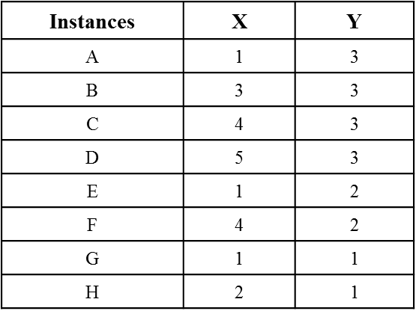
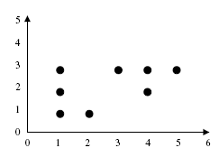
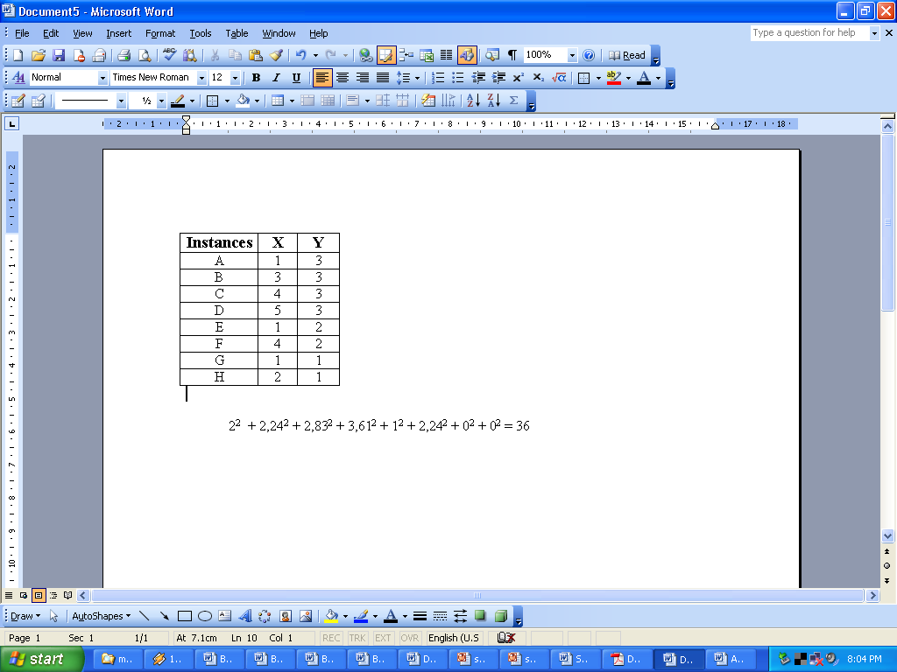
Contoh Kasus – Iterasi 1
Tentukan jumlah klaster k=2
Tentukan centroid awal secara acak misal dari data disamping m1 =(1,1), m2=(2,1)
Tempatkan tiap objek ke klaster terdekat berdasarkan nilai centroid yang paling dekat selisihnya (jaraknya). Didapatkan hasil, anggota cluster1 = {A,E,G}, cluster2={B,C,D,F,H}
Nilai SSE yaitu:

Slide 21
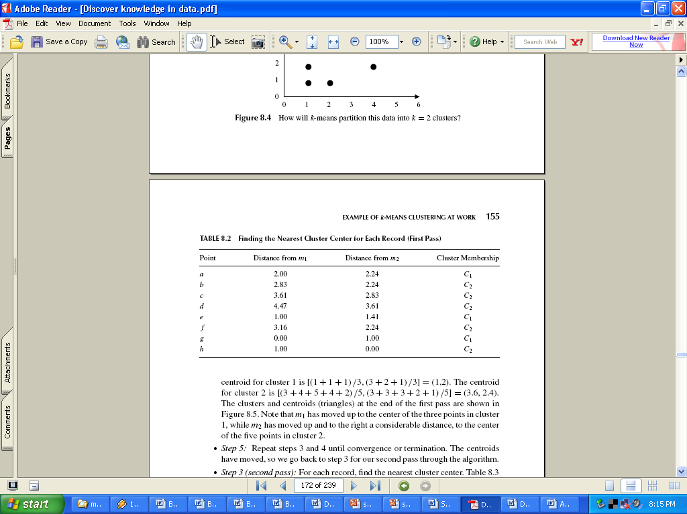
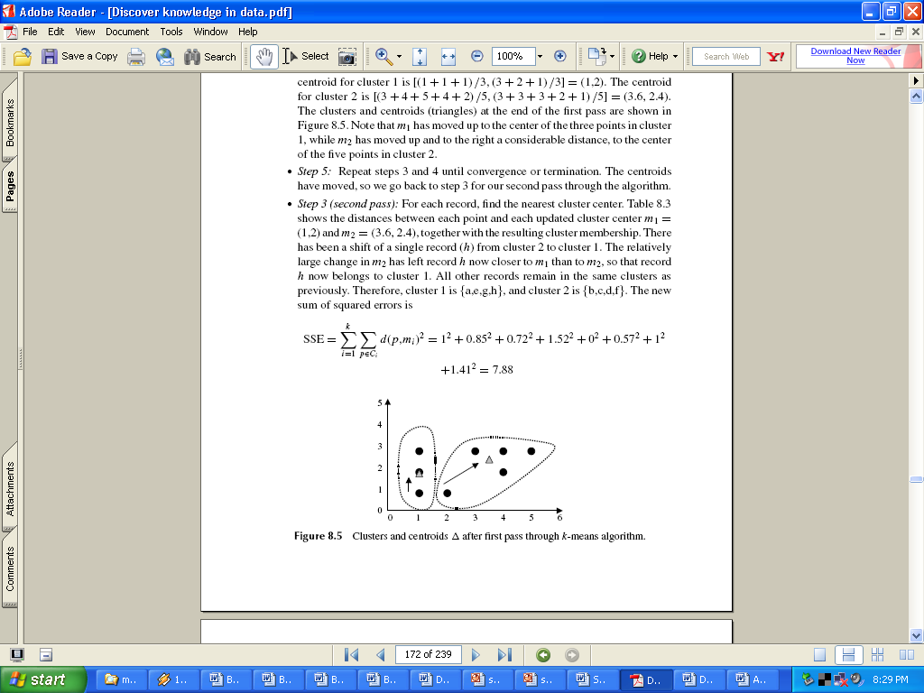
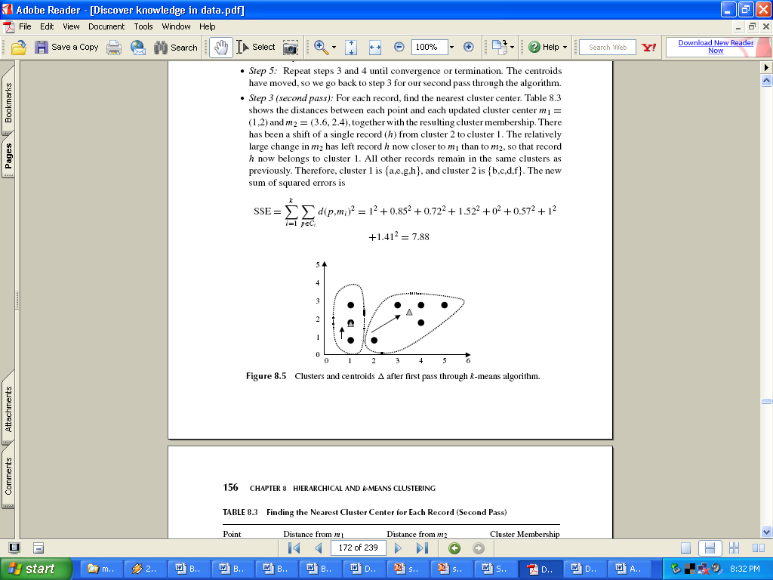
Interasi 2
Menghitung nilai centroid yang baru
Tugaskan lagi setiap objek dengan memakai pusat klaster yang baru.
Nilai SSE yang baru:

Slide 22
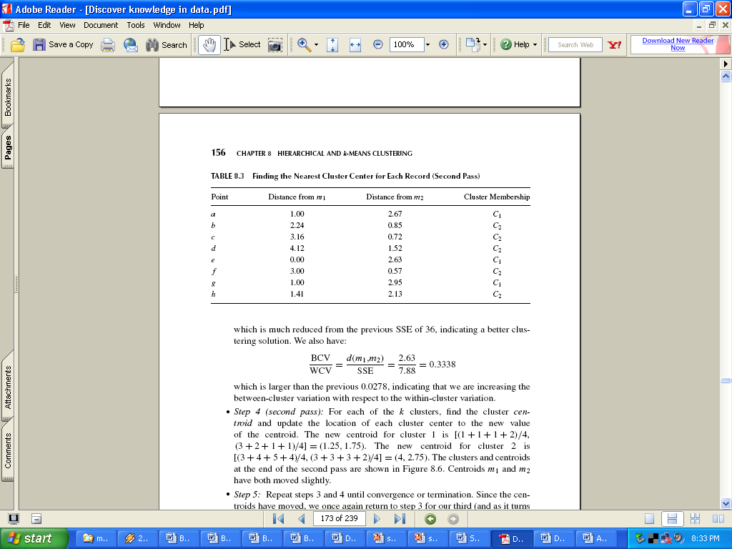
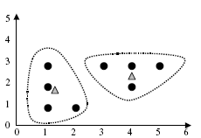
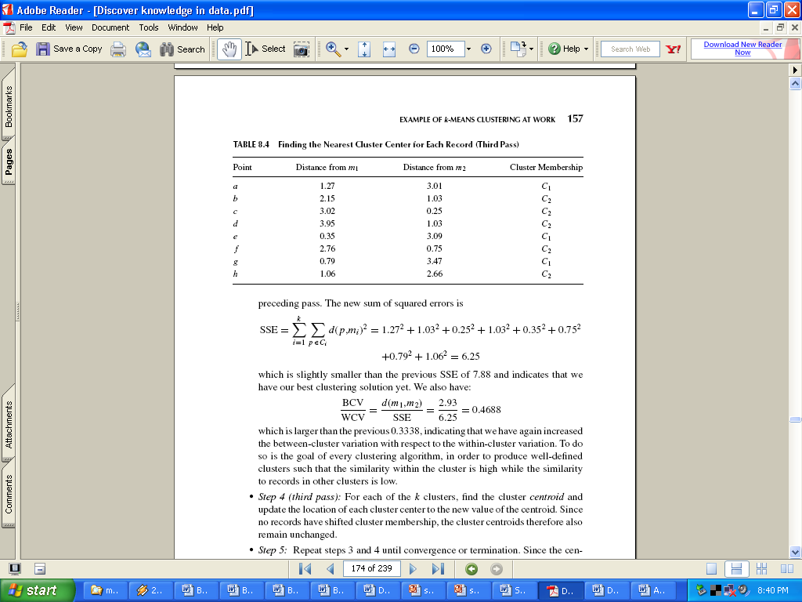
Iterasi 3
Terdapat perubahan anggota cluster yaitu cluster1={A,E,G,H}, cluster2={B,C,D,F}, maka cari lagi nilai centroid yang baru yaitu: m1=(1,25;1,75) dan m2=(4;2,75)
Tugaskan lagi setiap objek dengan memakai pusat klaster yang baru Nilai SSE yang baru:

Slide 23
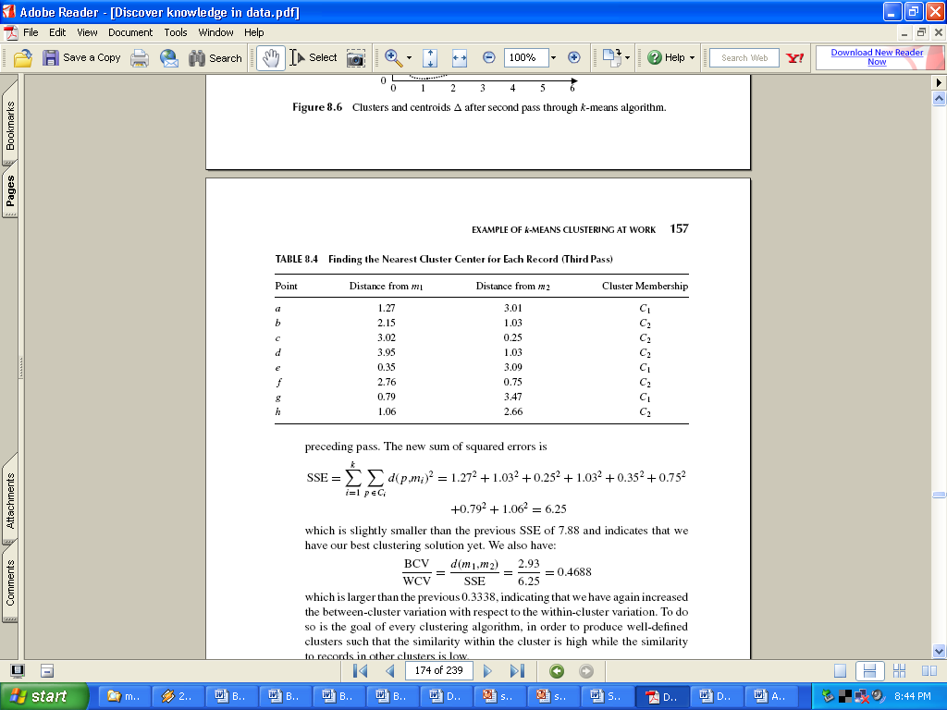
Hasil Akhir
Dapat dilihat pada tabel. Tidak ada perubahan anggota lagi pada masing-masing cluster
Hasil akhir yaitu: cluster1={A,E,G,H}, dan cluster2={B,C,D,F} Dengan nilai SSE = 6,25 dan jumlah iterasi 3

Slide 24
Latihan
Lakukan eksperimen mengikuti buku Matthew North, Data Mining for the Masses, 2012, Chapter 6 k-Means Clustering, pp. 91-103 (CoronaryHeartDisease.csv)
Gambarkan grafik (chart) dan pilih Scatter 3D Color untuk menggambarkan data hasil klastering yang telah dilakukan
Analisis apa yang telah dilakukan oleh Sonia, dan apa manfaat k-Means clustering bagi pekerjaannya?

Slide 25
Latihan
Lakukan pengukuran performance dengan menggunakan Cluster Distance Performance, untuk mendapatkan nilai Davies Bouldin Index (DBI)
Nilai DBI semakin rendah berarti cluster yang kita bentuk semakin baik

Slide 26
Latihan
Lakukan klastering terhadap data IMFdata.csv (https://github.com/achmatim/data-mining/tree/main/Dataset)

Slide 27
Comments on the K-Means Method
Strength:
Efficient: O(tkn), where n is # objects, k is # clusters, and t is # iterations. Normally, k, t << n.
Comparing: PAM: O(k(n-k)² ), CLARA: O(ks² + k(n-k))
Comment: Often terminates at a local optimal
Weakness
Applicable only to objects in a continuous n-dimensional space
Using the k-modes method for categorical data
In comparison, k-medoids can be applied to a wide range of data
Need to specify k, the number of clusters, in advance (there are ways to automatically determine the best k (see Hastie et al., 2009)
Sensitive to noisy data and outliers
Not suitable to discover clusters with non-convex shapes

Slide 28
Variations of the K-Means Method
Most of the variants of the k-means which differ in
Selection of the initial k means
Dissimilarity calculations
Strategies to calculate cluster means
Handling categorical data: k-modes
Replacing means of clusters with modes
Using new dissimilarity measures to deal with categorical objects
Using a frequency-based method to update modes of clusters
A mixture of categorical and numerical data: k-prototype method

Slide 29
What Is the Problem of the K-Means Method?
The k-means algorithm is sensitive to outliers!
Since an object with an extremely large value may substantially distort the distribution of the data
K-Medoids:
Instead of taking the mean value of the object in a cluster as a reference point, medoids can be used, which is the most centrally located object in a cluster
10
10
9
9
8
8
7
7
6
6
5
5
4
4
3
3
2
2
1
1
0
0
1
2
3
4
5
6
7
8
9
10
0
0
1
2
3
4
5
6
7
8
9
10

Slide 30
PAM: A Typical K-Medoids Algorithm
Total Cost = 20
10
9
8
Arbitrary choose k object as initial medoids
Assign each remaining object to nearest medoids
7
6
5
4
3
2
1
0
0
1
2
3
4
5
6
7
8
9
10
K=2
Randomly select a nonmedoid object,O_{ramdom}
Total Cost = 26
Do loop
Until no change
10
10
9
Compute total cost of swapping
9
Swapping O and O_{ramdom}
If quality is improved.
8
8
7
7
6
6
5
5
4
4
3
3
2
2
1
1
0
0
1
2
3
4
5
6
7
8
9
10
0
0
1
2
3
4
5
6
7
8
9
10
30
Notes:
30

Slide 31
The K-Medoid Clustering Method
K-Medoids Clustering: Find representative objects (medoids) in clusters
PAM (Partitioning Around Medoids, Kaufmann & Rousseeuw 1987)
Starts from an initial set of medoids and iteratively replaces one of the medoids by one of the non-medoids if it improves the total distance of the resulting clustering
PAM works effectively for small data sets, but does not scale well for large data sets (due to the computational complexity)
Efficiency improvement on PAM
CLARA (Kaufmann & Rousseeuw, 1990): PAM on samples
CLARANS (Ng & Han, 1994): Randomized re-sampling

Slide 32
2. Hierarchical Methods

Slide 33
Hierarchical Clustering
Use distance matrix as clustering criteria
This method does not require the number of clusters k as an input, but needs a termination condition
Step 0
Step 1
Step 2
Step 3
Step 4
agglomerative
(AGNES)
a
a b
b
a b c d e
c
c d e
d
d e
e
divisive
(DIANA)
Step 4
Step 3
Step 2
Step 1
Step 0

Slide 34
AGNES (Agglomerative Nesting)
Introduced in Kaufmann and Rousseeuw (1990)
Implemented in statistical packages, e.g., Splus
Use the single-link method and the dissimilarity matrix
Merge nodes that have the least dissimilarity
Go on in a non-descending fashion
Eventually all nodes belong to the same cluster

Slide 35
Dendrogram: Shows How Clusters are Merged
Decompose data objects into a several levels of nested partitioning (tree of clusters), called a dendrogram
A clustering of the data objects is obtained by cutting the dendrogram at the desired level, then each connected component forms a cluster

Slide 36
DIANA (Divisive Analysis)
Introduced in Kaufmann and Rousseeuw (1990)
Implemented in statistical analysis packages, e.g., Splus
Inverse order of AGNES
Eventually each node forms a cluster on its own

Slide 37
Distance between Clusters
Single link: smallest distance between an element in one cluster and an element in the other, i.e., dist(K_{i}, K_{j}) = min(t_{ip}, t_{jq})
Complete link: largest distance between an element in one cluster and an element in the other, i.e., dist(K_{i}, K_{j}) = max(t_{ip}, t_{jq})
Average: avg distance between an element in one cluster and an element in the other, i.e., dist(K_{i}, K_{j}) = avg(t_{ip}, t_{jq})
Centroid: distance between the centroids of two clusters, i.e., dist(K_{i}, K_{j}) = dist(C_{i}, C_{j})
Medoid: distance between the medoids of two clusters, i.e., dist(K_{i}, K_{j}) = dist(M_{i}, M_{j})
Medoid: a chosen, centrally located object in the cluster
X
X

Slide 38
Centroid, Radius and Diameter of a Cluster (for numerical data sets)
Centroid: the “middle” of a cluster
Radius: square root of average distance from any point of the cluster to its centroid
Diameter: square root of average mean squared distance between all pairs of points in the cluster

Slide 39
3. Density-Based Methods

Slide 40
Density-Based Clustering Methods
Clustering based on density (local cluster criterion), such as density-connected points
Major features:
Discover clusters of arbitrary shape
Handle noise
One scan
Need density parameters as termination condition
Several interesting studies:
DBSCAN: Ester, et al. (KDD’96)
OPTICS: Ankerst, et al (SIGMOD’99).
DENCLUE: Hinneburg & D. Keim (KDD’98)
CLIQUE: Agrawal, et al. (SIGMOD’98) (more grid-based)

Slide 41
Density-Based Clustering: Basic Concepts
Two parameters:
Eps: Maximum radius of the neighbourhood
MinPts: Minimum number of points in an Eps-neighbourhood of that point
N_{Eps}(q): {p belongs to D | dist(p,q) ≤ Eps}
Directly density-reachable: A point p is directly density-reachable from a point q w.r.t. Eps, MinPts if
p belongs to N_{Eps}(q)
core point condition:
|N_{Eps} (q)| ≥ MinPts
p
MinPts = 5
Eps = 1 cm
q

Slide 42
Density-Reachable and Density-Connected
Density-reachable:
A point p is density-reachable from a point q w.r.t. Eps, MinPts if there is a chain of points p₁, …, p_{n}, p₁ = q, p_{n} = p such that p_{i+1} is directly density-reachable from p_{i}
Density-connected
A point p is density-connected to a point q w.r.t. Eps, MinPts if there is a point o such that both, p and q are density-reachable from o w.r.t. Eps and MinPts
p
p₁
q
p
q
o

Slide 43
DBSCAN: Density-Based Spatial Clustering of Applications with Noise
Relies on a density-based notion of cluster: A cluster is defined as a maximal set of density-connected points
Discovers clusters of arbitrary shape in spatial databases with noise
Outlier
Border
Eps = 1cm
MinPts = 5
Core

Slide 44
DBSCAN: The Algorithm
Arbitrary select a point p
Retrieve all points density-reachable from p w.r.t. Eps and MinPts
If p is a core point, a cluster is formed
If p is a border point, no points are density-reachable from p and DBSCAN visits the next point of the database
Continue the process until all of the points have been processed
If a spatial index is used, the computational complexity of DBSCAN is O(nlogn), where n is the number of database objects. Otherwise, the complexity is O(n²)

Slide 45
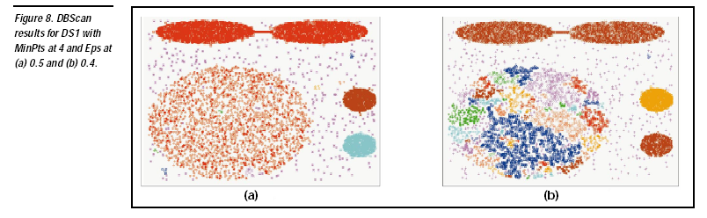
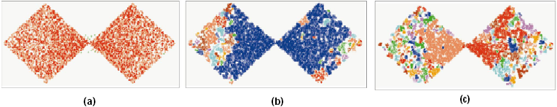
DBSCAN: Sensitive to Parameters
http://webdocs.cs.ualberta.ca/~yaling/Cluster/Applet/Code/Cluster.html

Slide 46
OPTICS: A Cluster-Ordering Method (1999)
OPTICS: Ordering Points To Identify the Clustering Structure
Ankerst, Breunig, Kriegel, and Sander (SIGMOD’99)
Produces a special order of the database wrt its density-based clustering structure
This cluster-ordering contains info equiv to the density-based clusterings corresponding to a broad range of parameter settings
Good for both automatic and interactive cluster analysis, including finding intrinsic clustering structure
Can be represented graphically or using visualization techniques

Slide 47
OPTICS: Some Extension from DBSCAN
Index-based: k = # of dimensions, N: # of points
Complexity: O(N*logN)
Core Distance of an object p: the smallest value ε such that the ε-neighborhood of p has at least MinPts objects
Let N_{ε}(p): ε-neighborhood of p, ε is a distance value
Core-distance_{ε, MinPts}(p) = Undefined if card(N_{ε}(p)) < MinPts
MinPts-distance(p), otherwise
Reachability Distance of object p from core object q is the min radius value that makes p density-reachable from q
Reachability-distance_{ε, MinPts}(p, q) =
Undefined if q is not a core object
max(core-distance(q), distance (q, p)), otherwise

Slide 48
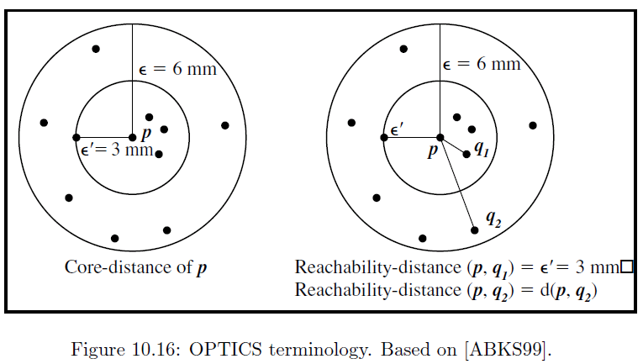
Core Distance & Reachability Distance

Slide 49
Reachability-distance
undefined
‘
Cluster-order of the objects

Slide 50
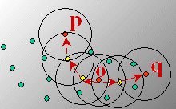
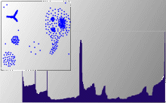
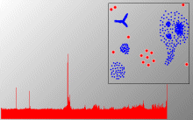
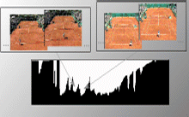
Density-Based Clustering: OPTICS & Applications
http://www.dbs.informatik.uni-muenchen.de/Forschung/KDD/Clustering/OPTICS/Demo

Slide 51
4. Grid-Based Methods

Slide 52
Grid-Based Clustering Method
Using multi-resolution grid data structure
Several interesting methods
STING (a STatistical INformation Grid approach) by Wang, Yang and Muntz (1997)
WaveCluster by Sheikholeslami, Chatterjee, and Zhang (VLDB’98)
A multi-resolution clustering approach using wavelet method
CLIQUE: Agrawal, et al. (SIGMOD’98)
Both grid-based and subspace clustering

Slide 53
STING: A Statistical Information Grid Approach
Wang, Yang and Muntz (VLDB’97)
The spatial area is divided into rectangular cells
There are several levels of cells corresponding to different levels of resolution

Slide 54
The STING Clustering Method
Each cell at a high level is partitioned into a number of smaller cells in the next lower level
Statistical info of each cell is calculated and stored beforehand and is used to answer queries
Parameters of higher level cells can be easily calculated from parameters of lower level cell
count, mean, s, min, max
type of distribution—normal, uniform, etc.
Use a top-down approach to answer spatial data queries
Start from a pre-selected layer—typically with a small number of cells
For each cell in the current level compute the confidence interval

Slide 55
STING Algorithm and Its Analysis
Remove the irrelevant cells from further consideration
When finish examining the current layer, proceed to the next lower level
Repeat this process until the bottom layer is reached
Advantages:
Query-independent, easy to parallelize, incremental update
O(K), where K is the number of grid cells at the lowest level
Disadvantages:
All the cluster boundaries are either horizontal or vertical, and no diagonal boundary is detected

Slide 56
CLIQUE (Clustering In QUEst)
Agrawal, Gehrke, Gunopulos, Raghavan (SIGMOD’98)
Automatically identifying subspaces of a high dimensional data space that allow better clustering than original space
CLIQUE can be considered as both density-based and grid-based
It partitions each dimension into the same number of equal length interval
It partitions an m-dimensional data space into non-overlapping rectangular units
A unit is dense if the fraction of total data points contained in the unit exceeds the input model parameter
A cluster is a maximal set of connected dense units within a subspace

Slide 57
CLIQUE: The Major Steps
Partition the data space and find the number of points that lie inside each cell of the partition.
Identify the subspaces that contain clusters using the Apriori principle
Identify clusters
Determine dense units in all subspaces of interests
Determine connected dense units in all subspaces of interests.
Generate minimal description for the clusters
Determine maximal regions that cover a cluster of connected dense units for each cluster
Determination of minimal cover for each cluster

Slide 58
Salary (10,000)
Vacation(week)
7
7
6
6
5
5
4
4
3
3
2
2
1
1
0
age
0
age
20
30
40
50
60
20
30
40
50
60
τ = 3
Vacation
Salary
30
50
age

Slide 59
Strength and Weakness of CLIQUE
Strength
automatically finds subspaces of the highest dimensionality such that high density clusters exist in those subspaces
insensitive to the order of records in input and does not presume some canonical data distribution
scales linearly with the size of input and has good scalability as the number of dimensions in the data increases
Weakness
The accuracy of the clustering result may be degraded at the expense of simplicity of the method

Slide 60


Kesimpulan
SELESAI

